Slide 1

Insight into Football Analytics
by Menno Branger
Sep-2023

Slide 2
Contents
1
3
Project objective and data exploration
2
4
The journey to develop a xG Model (Expected Goals Model)
3
5
Several player analyses
4
9
Conclusions about xG Model

Slide 3

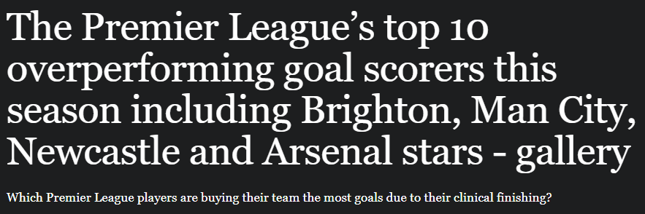
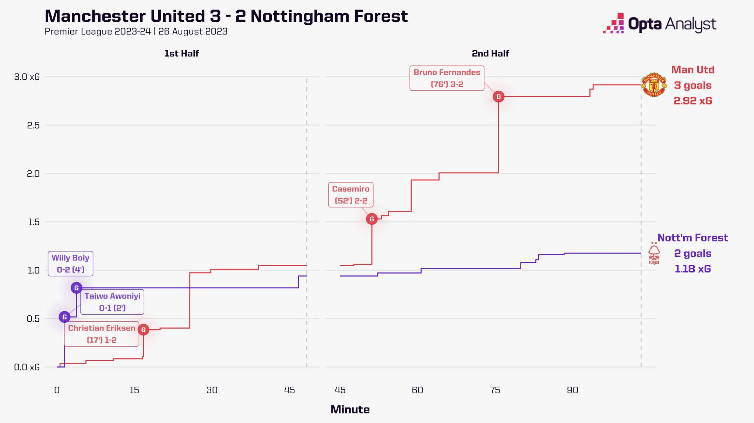
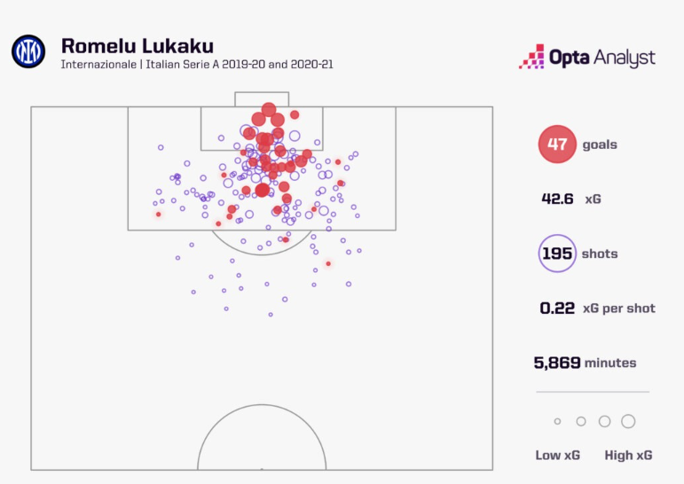
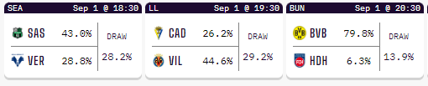
Developing my own Expected Goals (xG) model and finding the most prolific player was this project’s objective..
“What are the key variables and methodologies for constructing a personalised Expected Goals (xG) Model, and which player emerges as the most prolific scorer when evaluated using this custom xG model?”

Slide 4
..As the journey is more important than the destination, we review the steps taken to establish an xG Model..
1. Data Exploration
2. What are Expected Goals?
3. How to prepare the data?
The public data set captures spatio-temporal match events in >7,000 football games, containing information about different in-game occurrences in from the top 5 European Leagues from 2011 to 2016
These events encompass various actions such as shots, passes, crosses, set pieces, and more
The data set provides valuable insights into the dynamics of matches beyond just goal counts, enabling detailed analysis of team and player performance
An Expected Goals (xG) model aim to quantify the likelihood of a shot resulting in a goal
This metric offers a comprehensive perspective on match events beyond the mere number of goals scored
xG models focus on shots since goals are primarily generated from shots, making shot-related data essential for development
X and Y sets are essential inputs for the xG Model, where Y represents whether a shot resulted in a goal (1) or not (0), serving as the target variable
X includes pertinent shot information: location, body part used (foot, head), assist method, situation (open play, set piece, etc.), and whether the shot resulted from a fast break (binary: 1 or 0)
Shot location categories provide details such as attacking half, defensive half, specific areas in the box, wings, and different ranges

Slide 5
..The results of our xG Model to find out the most prolific player are not surprising and confirm the Model’s validity..
Best finishers
Best goalscorers

Slide 6
..Looking more into the specifics, we can clearly see what players are extremely efficient and are overperforming..
Best finishers (relative value, min. 30 goals)
Most efficient finishers

Slide 7

..The Model also allows us to see what specialists there are and how this holds to 4 of the best finishers..
Best finishers (by body part)
4 of the best finishers (by body part, relative value)
Difference between Goals scored and xG

Slide 8
..The xG Model also provides insights on what players are most creative and who often feels ‘lucky’..
Best long-range shooters (relative value)
Most dangerous passers

Slide 9
..Our Model performs well, but could be improved through the use of more algorithms and more data points
1
Algorithmic Exploration
Experimenting with different algorithms, such as Gradient Boosters with diverse hyperparameters, can provide alternative perspectives on the data and potentially uncover nuances in the xG predictions. This exploration could help validate the model's current output and contribute to its robustness by confirming consistent results across different algorithmic approaches
2
Incorporating Additional Data
Augmenting the model with richer features, such as defensive team information (number of defenders, defensive pressure, player's time/space for shooting), can enhance prediction accuracy. Quantitative answers to these defensive-related questions could introduce nuanced contextual insights, potentially leading to more precise xG estimations and a better understanding of how defensive factors influence goal-scoring probabilities
3
Fine-grained Shot Location
While the model benefits from the existing 17-shot location categories, incorporating precise x and y coordinates of player positions during shots could elevate predictive accuracy. This finer granularity could enable the model to capture spatial intricacies and provide more nuanced predictions based on exact player positioning, ultimately refining its ability to predict goal-scoring probabilities with greater precision

